Slide 1
High-resolution Ice and Ocean Modeling and Assimilation System (HIOMAS)
Jinlun Zhang
Polar Science Center
Applied Physics Lab
University of Washington

Slide 2
Slide2: Objectives of the ADAC HIOMAS Project
Support USCG Arctic operators and planners by developing a High-resolution Ice-Ocean Modeling and Assimilation System (HIOMAS) to predict Arctic sea ice thickness, motion, and edge location, ocean currents, and other useful parameters.
Help USCG to conduct search and rescue missions more safely and reliably; enhance USCG’s ability to prepare for and respond to disasters such oil spills.
Support other Arctic stakeholders in planning and management of economic activities.
Support other modeling efforts such as oil spill and storm surge modeling that may use high-resolution output as forcing.
Notes:
2

Slide 3
Slide3: Key Model Features of HIOMAS
Developed based on the Pan-Arctic Ice-Ocean Modeling and Assimilation System (PIOMAS), but with much higher resolution.
Parallel Ocean Program (POP, Dukowicz/Smith 1994).
8-category subgrid-scale thickness & enthalpy distribution (TED) sea ice model covering ice thickness up to 28 m; 8-category subgrid-scale snow depth distribution (Zhang/Rothrock 2003).
Teardrop viscous-plastic sea ice rheology allowing biaxial tensile stress useful for both drift and fast ice (Zhang/Rothrock, 2005).
Sea ice dynamics model for efficient, stable, high-resolution solution of ice motion, deformation & ridging (Zhang/Hibler 1997).
Assimilates daily satellite sea ice concentration in hindcasts.
Uniform 2 km resolution for the whole Arctic Ocean with 40 ocean levels.
Notes:
3

Slide 4
Slide4: HIOMAS Sea Ice-Ocean Hindcast/Forecast System
Forecasts are initialized with hindcasts that assimilate satellite sea ice concentration to obtain “best” possible initial conditions.
Hindcasts are driven by NCEP/NCAR reanalysis that assimilates a variety of satellite and in situ observations.
Forecasts are driven by atmospheric forecast forcing from the NCEP Climate Forecast System (CFS). Forecast range is up to 3 months; focus on 1 month.
HIOMAS has been transitioned to Axiom Data Sciences, a NOAA affiliate.
Biweekly HIOMAS hindcast and forecast are now conducted at Axiom; one week of hindcast data and one month of forecast data are provided by Axiom.
Notes:
4

Slide 5
Slide5: Typical HIOMAS Hindcast/Forecast Output
2D sea ice thickness, concentration, and velocity.
2D sea ice internal stress, deformation, fraction of thin ice, fraction of ridged/thick ice, and major leads (maybe useful for Arctic operators and planners and for oil spill modeling).
2D sea ice melt and freezing.
2D snow depth.
3D ocean velocity, temperature, and salinity.
All at uniform 2 km horizontal resolution.
http://thredds.aoos.org/thredds/catalog.html?dataset=HIOMAS_2KM_HINDCAST
http://thredds.aoos.org/thredds/catalog.html?dataset=HIOMAS_2KM_FORECAST
Notes:
5

Slide 6
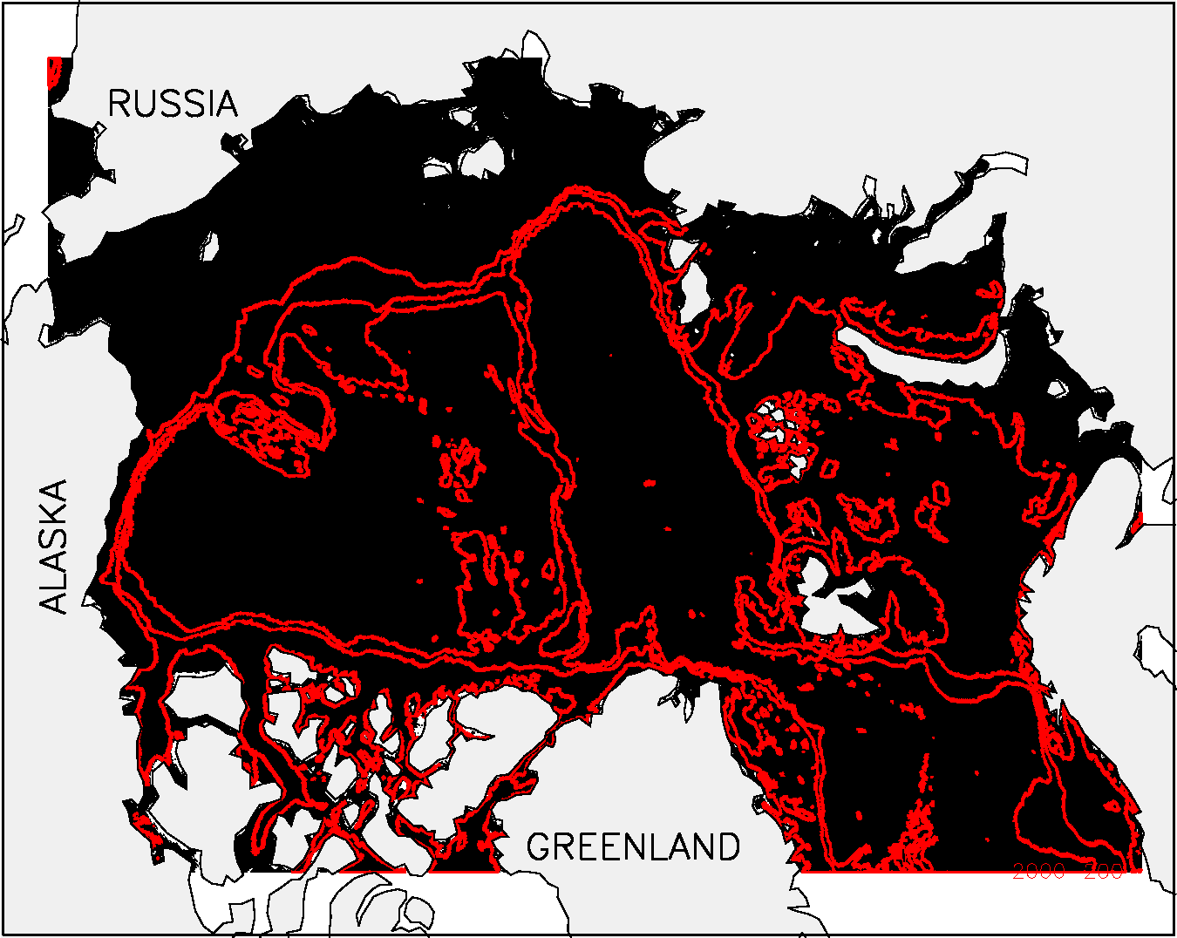
Slide6: HIOMAS grid configuration: uniform 2 km resolution
isobaths at:
200m
1000m
2000 m
Black lines are used
to draw 2x2 km grid
cells, but the cells are
not visible because of high resolution.
Notes:
6

Slide 7
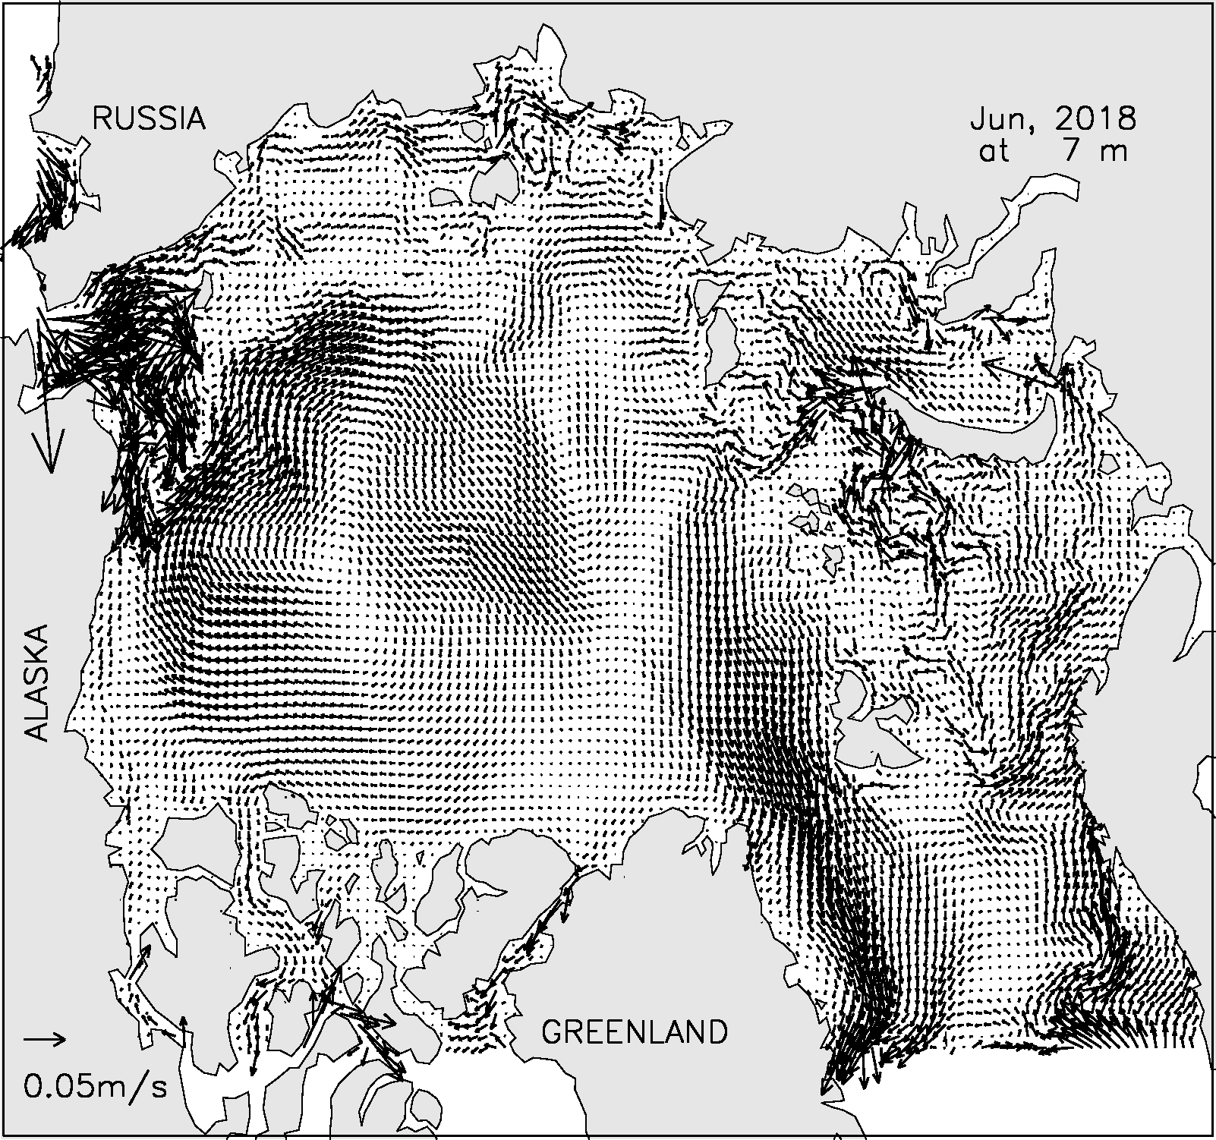
Slide7: HIOMAS ocean surface velocity (June 2018)
Only 0.25% of velocity vectors are plotted for clarity
i.e. each vector in map represents 400 vectors in model grid
Notes:
7

Slide 8
Slide8: HIOMAS sea ice thickness compared with
CryoSat2 ice thickness data over 2013-2017
=>CryoSat2 sea ice thickness data points: 590400
=>CryoSat2 ice thickness mean: 2.02 m
=>Model ice thickness mean: 2.27 m
=>Model mean bias: 0.25 m or 12%
=>Model-data correlation: 0.66
Notes:
8

Slide 9
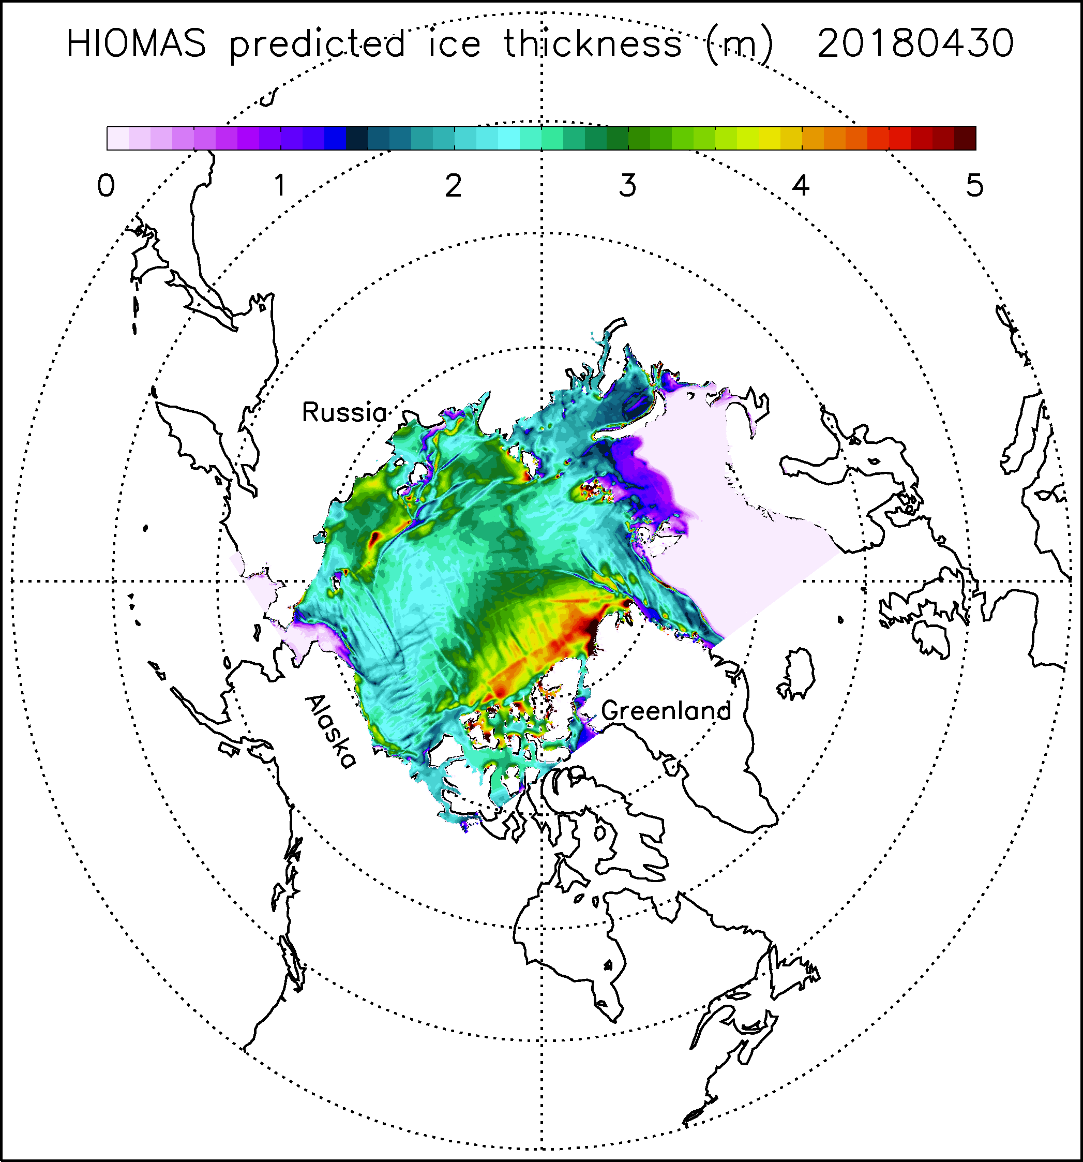
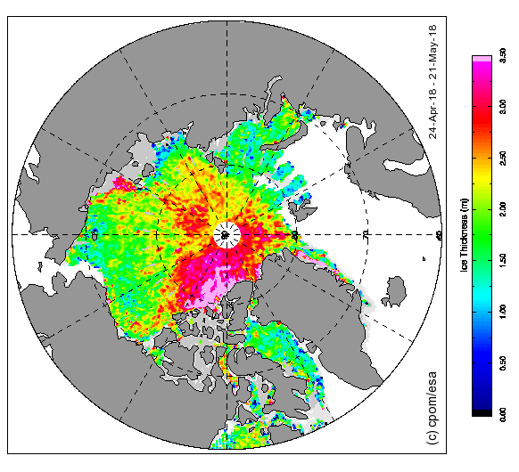
Slide9: Sea ice thickness comparison between HIOMAS and CryoSat2 on or around 4/30/2018
From CryoSat2
(25 km resolution)
over 4/24-5/21/2018
From HIOMAS on 4/30/2018
Notes:
9

Slide 10
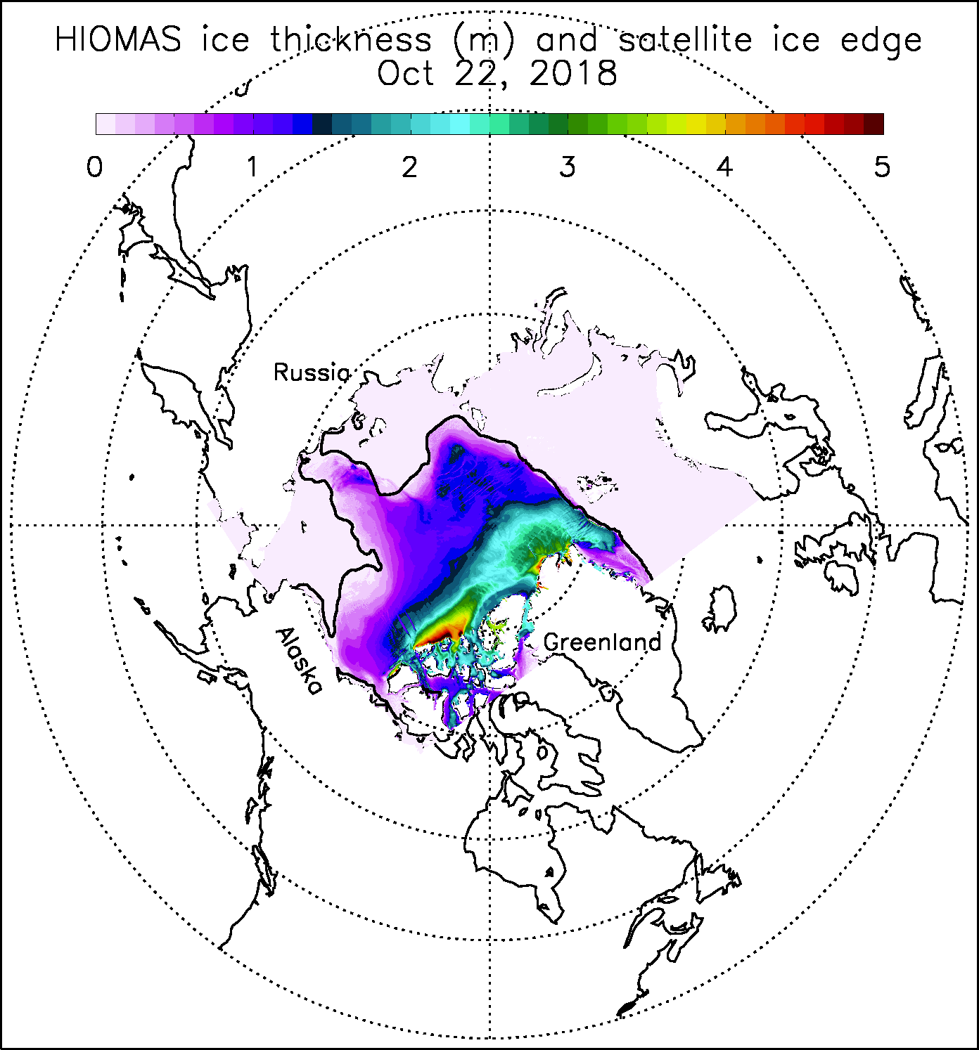
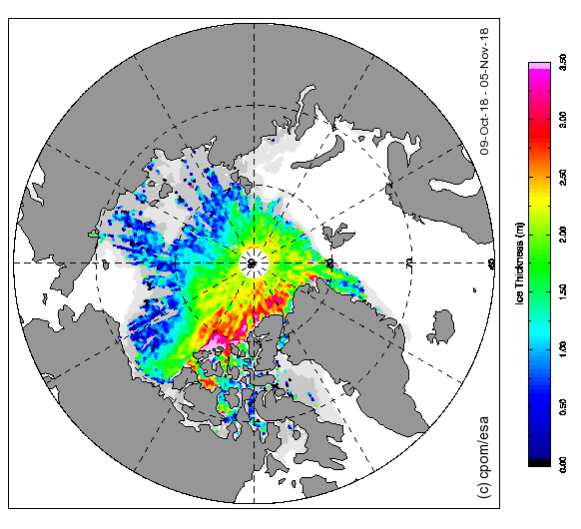
Slide10: Sea ice thickness comparison between HIOMAS and CryoSat2 on or around 10/22/2018
From CryoSat2
(25 km resolution)
over 10/9-11/5/2018
From HIOMAS on 10/22/2018
Notes:
10

Slide 11
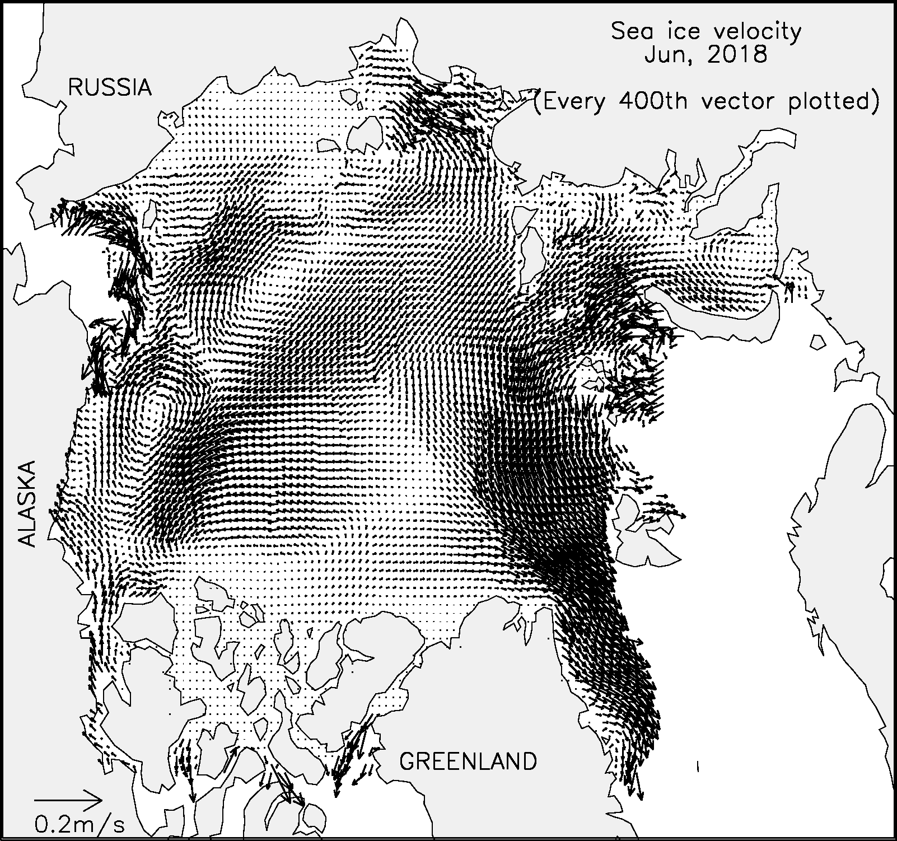
Slide11: HIOMAS sea ice velocity (June 2018)
One of every 400 velocity vectors is plotted
Notes:
11

Slide 12
Slide12: HIOMAS sea ice velocity compared with
IABP* buoy drift velocity data over 2014-2015
=>Buoy drift velocity data points: 21968
=>Buoy drift velocity mean: 0.095 m/s
=>Model ice velocity mean: 0.080 m/s
=>Model mean bias: -0.015 m/s or -16%
=>On average HIOMAS ice speed is lower than buoy
speed, but higher than satellite derived ice speed
*IABP: International Arctic Buoy Program
Notes:
12

Slide 13
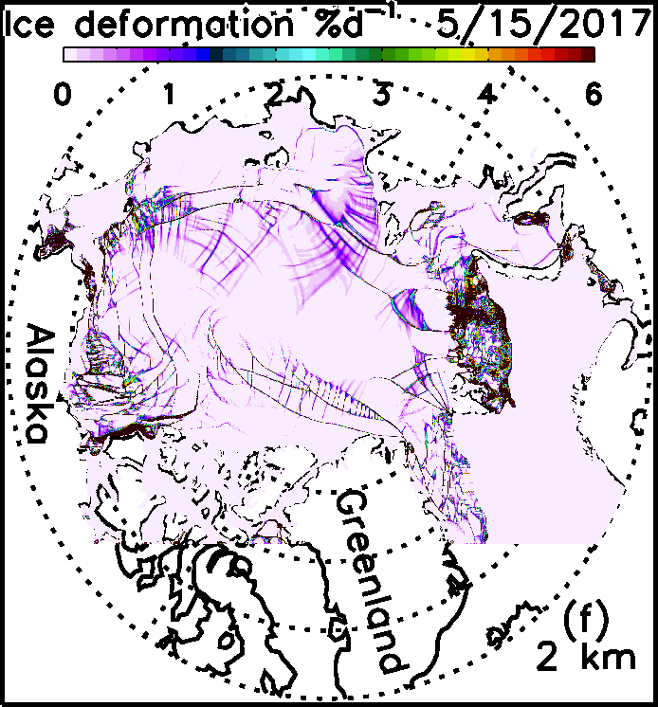
Slide13: Rough HIOMAS vs. SAR comparison of ice deformation on or around May 15
SAR derived sea ice deformation
during 5/17-23/2007
(SAR = Synthetic Aperture Radar)
HIOMAS sea ice deformation
on 5/15/2017
Notes:
13

Slide 14
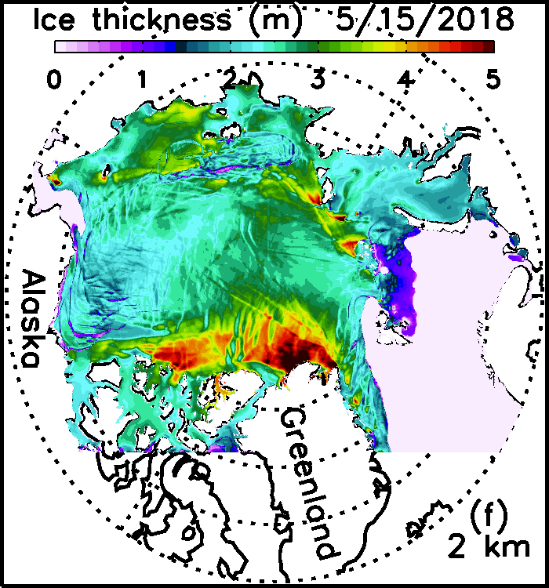
Slide14: Major leads and cracks showing up in HIOMAS ice thickness field
Notes:
14

Slide 15
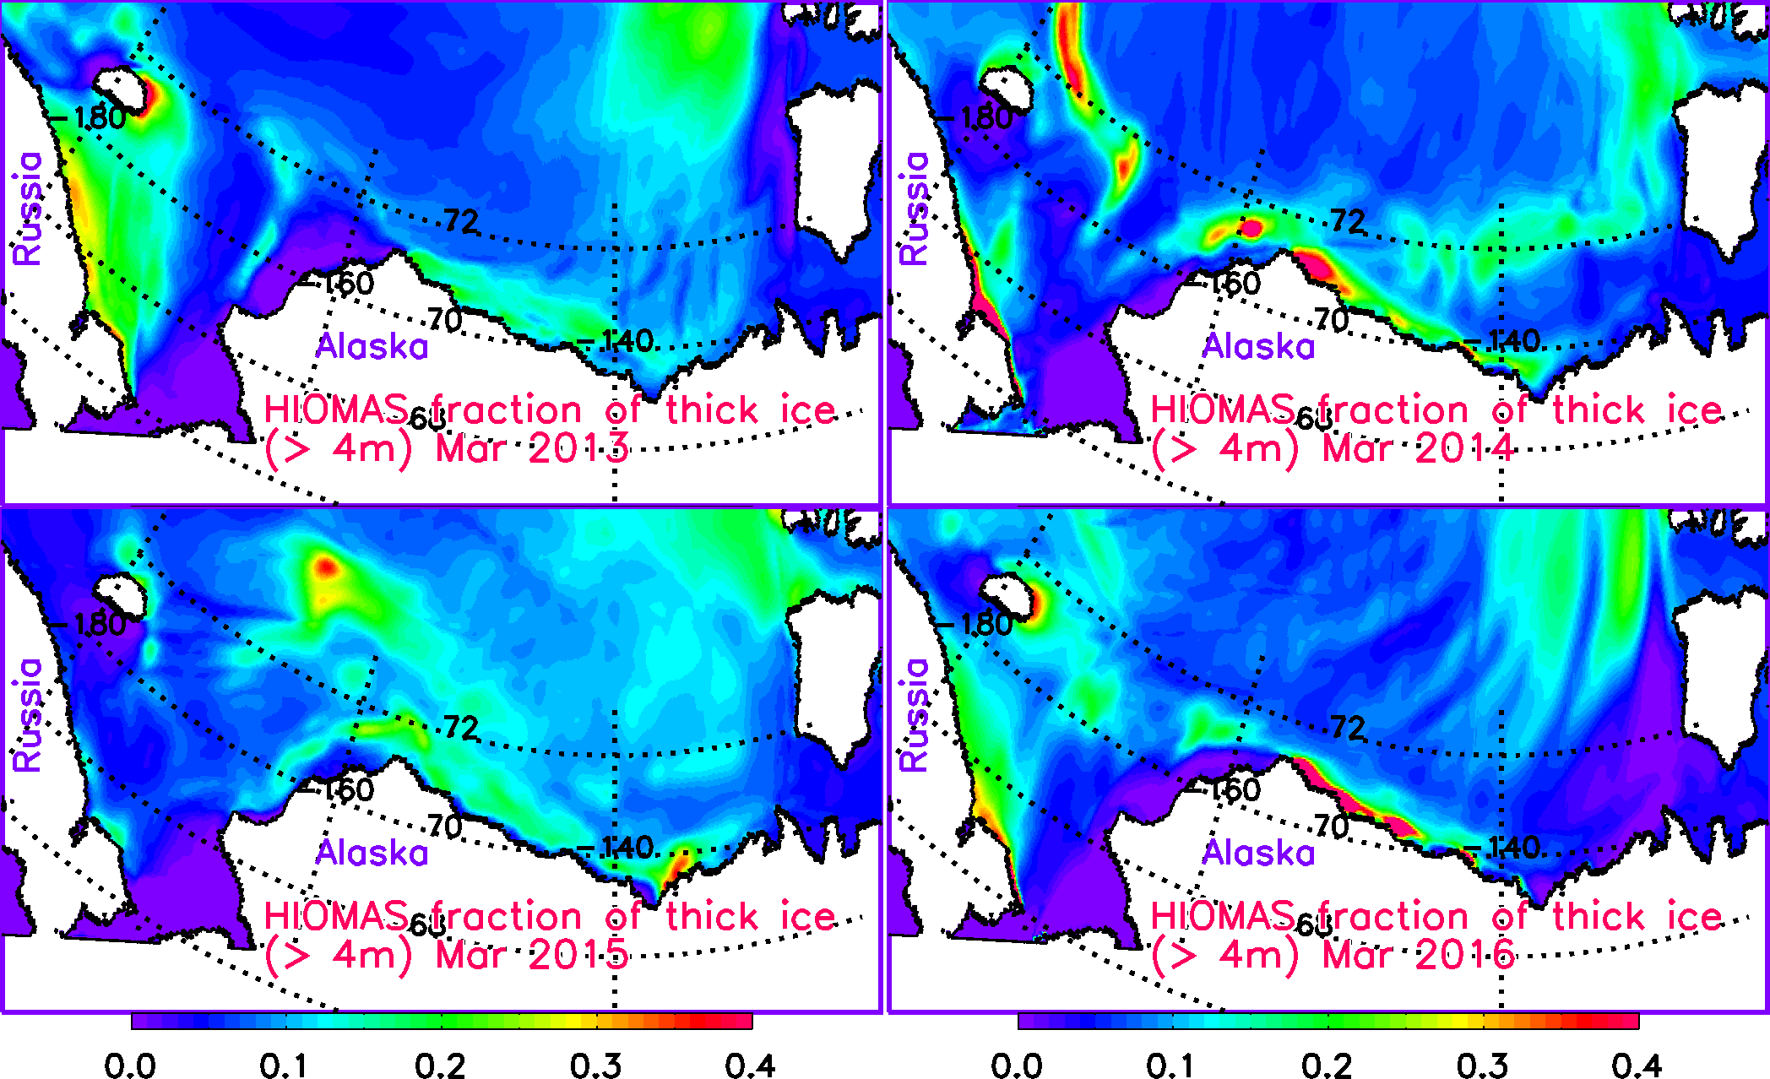
Slide15: Fraction of ridged thick ice (> 4 m)
High fraction of thick ice → reduced navigability even for icebreakers

Slide 16
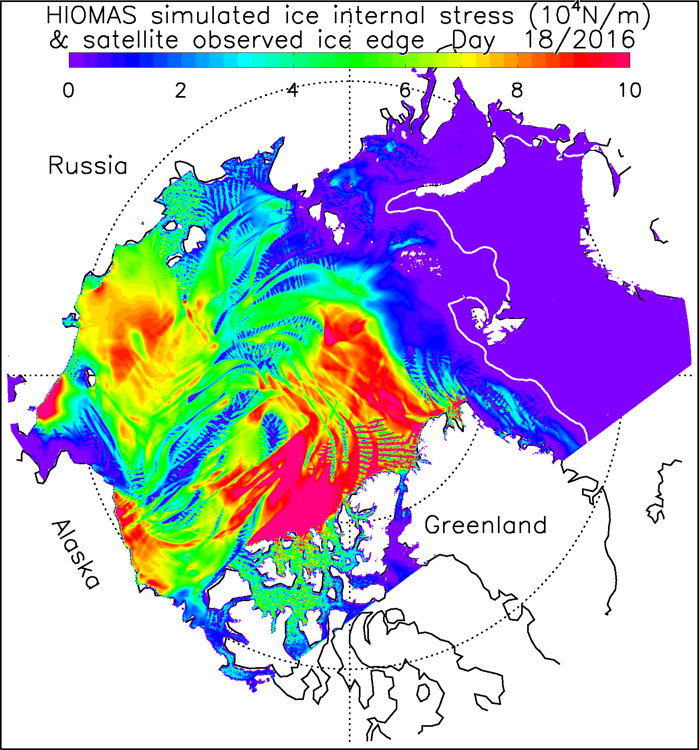
Slide16: Internal ice stress on day 18, 2016
Model-derived field indicates level of stress within ice pack
Red areas indicate
high pressure
→ reduced navigability
Notes:
16

Slide 17
Slide17: Summary
HIOMAS is developed based on PIOMAS but with much higher resolution (2 km).
HIOMAS assimilates satellite sea ice concentration.
HIOMAS is able to realistically simulate Arctic sea ice thickness and drift in reasonable agreement with some of the observational data.
HIOMAS is able to capture some main features of upper ocean circulation.
HIOMAS hindcast/forecast data are generated by Axiom now.
One week of hindcast data and one month of forecast data are provided by Axiom bi-weekly.
Notes:
17

Slide 18
Thank you! zhang@apl.Washington.edu
Notes:
18

